Slide 1



Slide 2



THIRD BYTE
The Ultimate Coding Challenge
Team ID: CLE-29
Name of Your Team: CrackedLog
Date: 26/09/2025

Slide 3

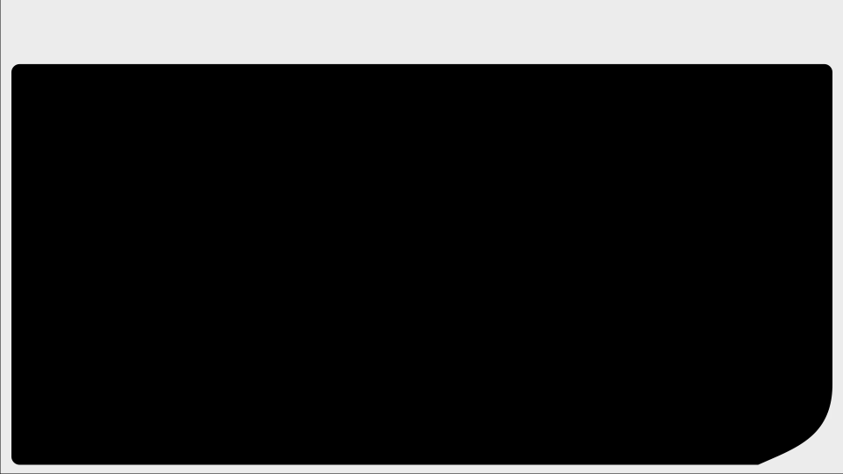
Team Details
Total Members in a Team: (1/2/3)
Name: Rohit Solanki
Enrollment No: 92400120628
Division: 3EV5
Name: Rishi Jat
Enrollment No: 92400120457
Division: 3EV3

Slide 4
Outline
Theme and Title
Problem Statement
Proposed Solution
Screenshots
Conclusion
References

Slide 5
Campus Life Enhancer
Theme & Title
Platform for MU student to Connect and Grow
Platform name MU Connect

Slide 6
Problem Statement
❌ Lack of a dedicated digital hub for MU students
❌ Academic + Social interactions scattered across:
WhatsApp groups, Telegram, LinkedIn, Clubs
❌ Informal & unorganized communication (DM a senior, random groups)
❌ No structured way to connect with seniors/juniors, share knowledge, or discover peers

Slide 7
Proposed Solution
Proposed Solution by us
✨ MU Connect – A closed social platform for MU students
Key Features:
📰 Twitter/X-like Social Feed
✅ University Email Authentication (@marwadieducation.edu.in)
👥 User Discovery & Follow System
🔖 Trending Topics & Hashtags
🛠 Admin Dashboard for Management
📱 Responsive Modern UI (Tailwind + Radix + Lottie)
📌 Future Enhancements:
Real-time messaging
Event management system
Study groups
Native mobile app
👉 MU Connect is positioned as the digital hub of student life at Marwadi University.

Slide 8
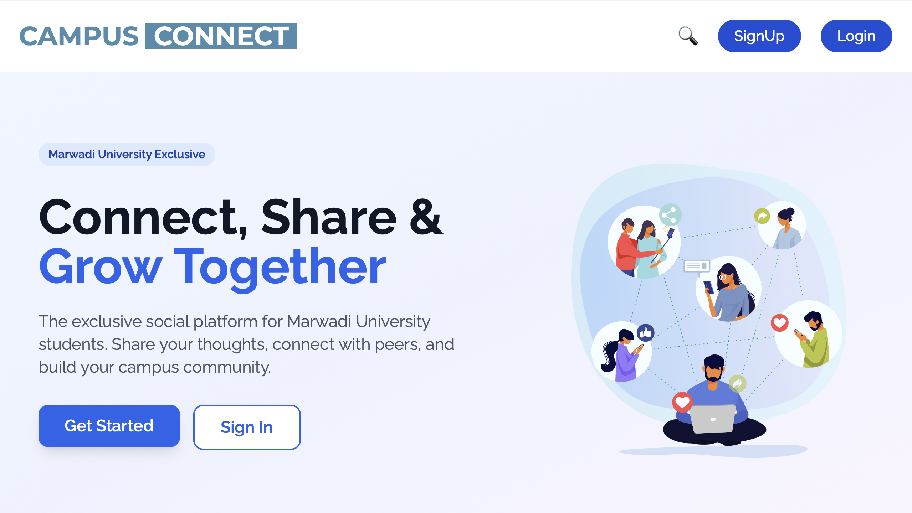
Screenshots
~ Flow of the platform

Slide 9
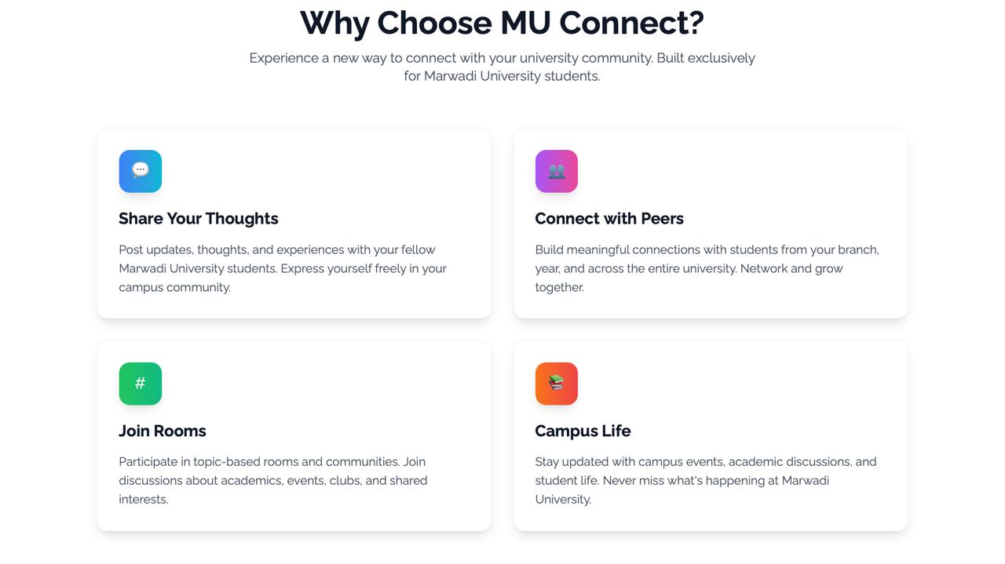
Screenshots

Slide 10
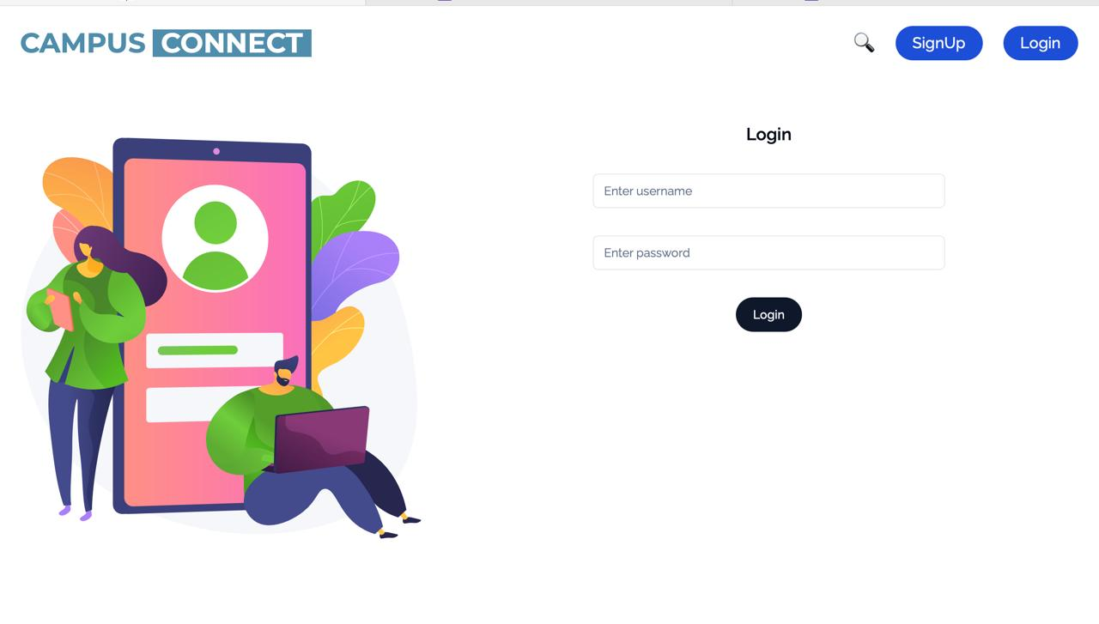
Screenshots

Slide 11
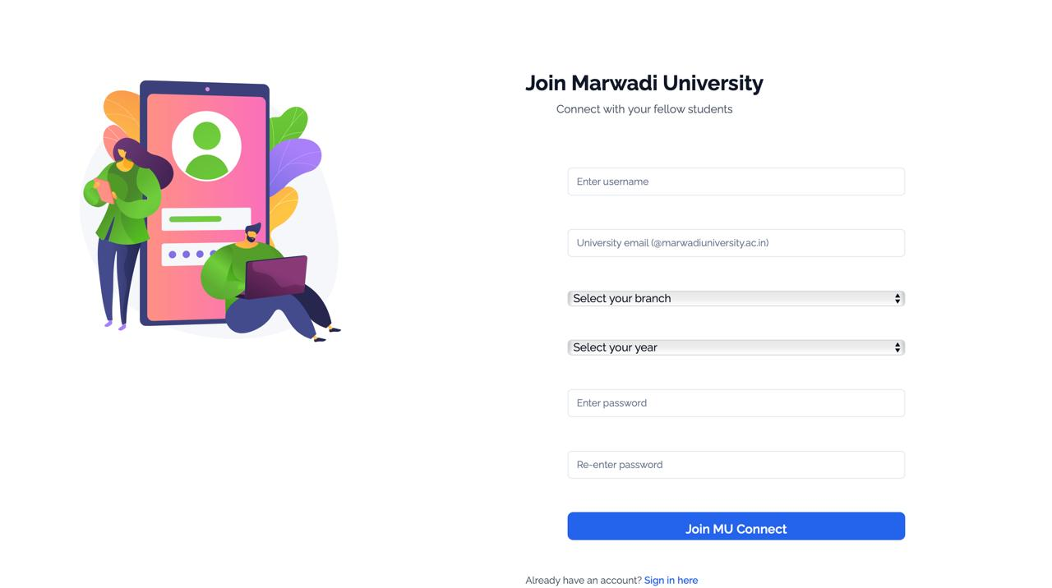
Screenshots

Slide 12
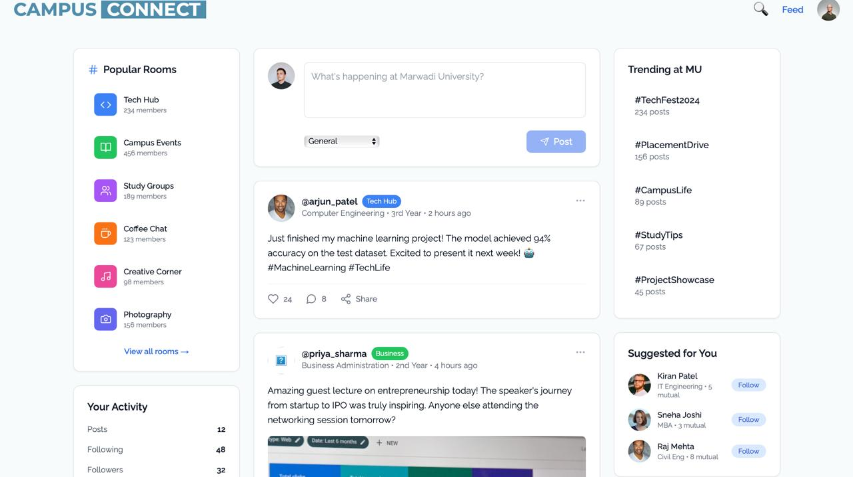
Screenshots

Slide 13
Conclusion
Conclusion (Unique Version)
🌐 Closed Digital Ecosystem – A platform where only MU students belong,
ensuring authentic and relevant connections.
✨ Familiar Yet Tailored – A Twitter/X-inspired interface redesigned with
academic and campus life in mind, making adoption seamless.
🛡 Future-Ready & Secure – Built with scalable architecture and strong
security protocols, ensuring trust as the platform grows.
🤝 Beyond Socializing – Not just a feed, but a bridge between academics,
culture, and peer learning, strengthening the MU community spirit.

Slide 14
References
📚 References for Your Pitch :~
Problem Statement (Interview Struggles)
Google’s Interview Warmup (inspiration for your app) Link : ~ https://grow.google/certificates/interview-warmup/
Voice-to-Text AI: OpenAI Whisper (speech-to-text) https://github.com/openai/whisper
AI-powered mock interviews in colleges/universities → EdTech Review: AI in Interview Preparation
Link :~ https://edtechreview.in/news/ai-powered-interview-prep-tools/

Slide 15

Thank
You

